Slide 1




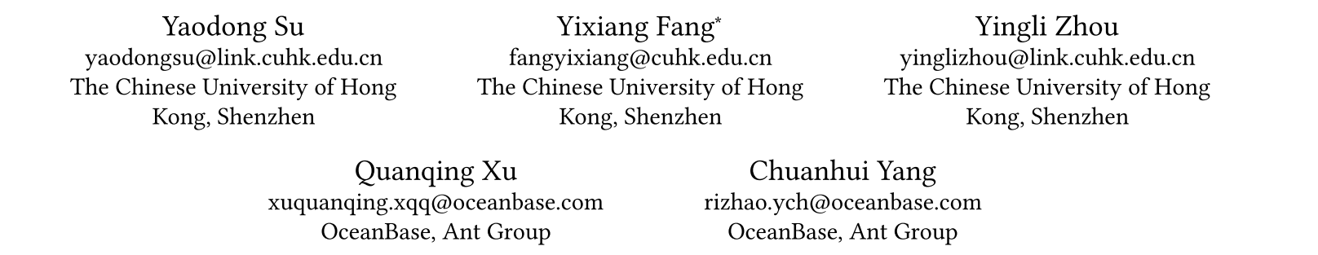





ATAI
Advanced Technique of Artificial Intelligence
ATAI
ChongqingUniversity _{AdvancedTechniqueof}
of Technology Artificial Intelligence
Chongqing University of
Technology
Chongqing University ^{ATAI}
_{of Technology} Advanced Techniqueof
Artificial Intelligence
Chongqing University of Technology
Chongqing University of Technology
Clue-RAG Towards Accurate and Cost Efficient Graph based RAG via Multi Partite Graph and Query Driven Iterative Retrieval
Code:https://github.com/Feesuu/ClueRAG
——KDD 2025
Reported by Xiang Zhang
1

Slide 2
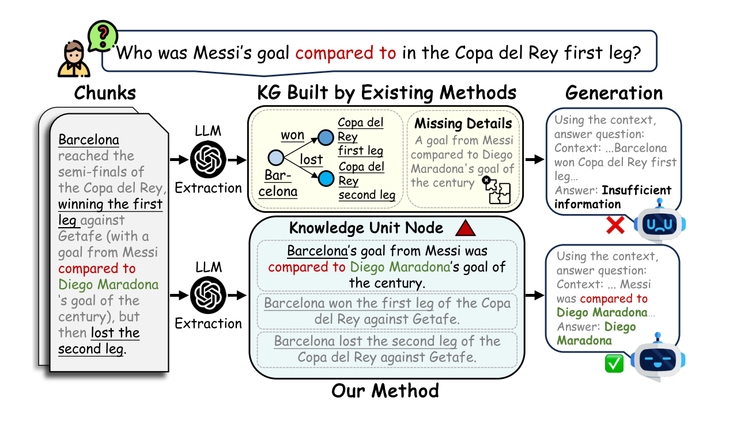
ATAI
Advanced Technique of Artificial Intelligence
ATAI
ChongqingUniversity _{AdvancedTechniqueof}
of Technology Artificial Intelligence
Chongqing University of
Technology
Chongqing University ^{ATAI}
_{of Technology} Advanced Techniqueof
Artificial Intelligence
Chongqing University of Technology
Chongqing University of Technology
Motivation
(1)The constructed KGs often suffer from incompleteness, typically due to missing key nodes, edges, or the omission of information that cannot be incorporated into structured graph elements.Existing methods typically extract only a few triples, while completely ignoring valuable textual information,
(2)Retrieve additional information based on the above elements often fails to fully leverage the query information, leading to a semantic misalignment between the query and the retrieved context.

Slide 3
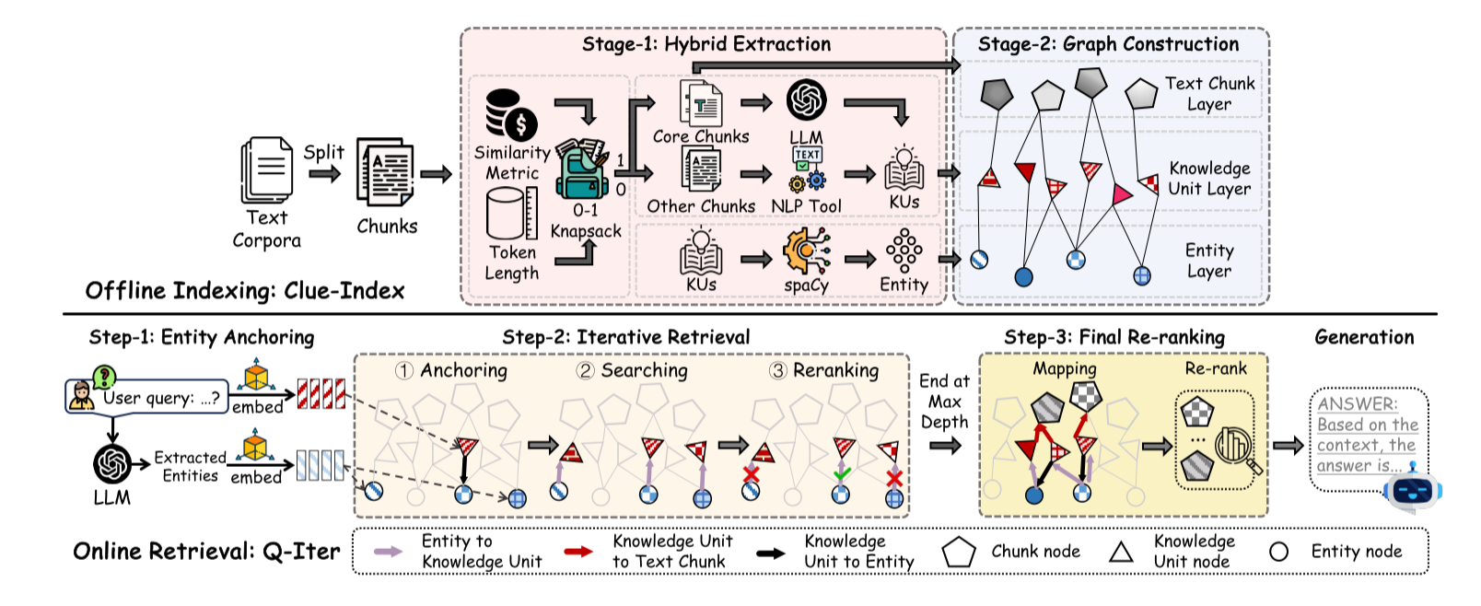
ATAI
Advanced Technique of Artificial Intelligence
ATAI
ChongqingUniversity _{AdvancedTechniqueof}
of Technology Artificial Intelligence
Chongqing University of
Technology
Chongqing University ^{ATAI}
_{of Technology} Advanced Techniqueof
Artificial Intelligence
Chongqing University of Technology
Chongqing University of Technology
Overview

Slide 4
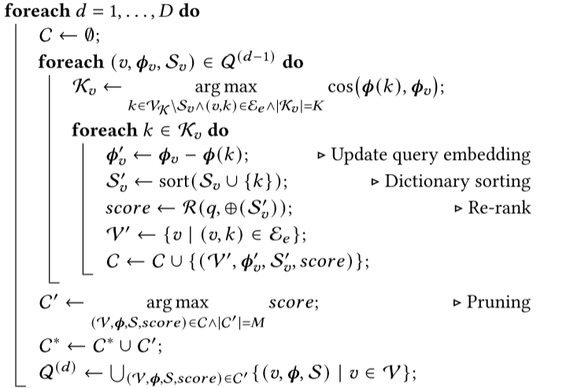
ATAI
Advanced Technique of Artificial Intelligence
ATAI
ChongqingUniversity _{AdvancedTechniqueof}
of Technology Artificial Intelligence
Chongqing University of
Technology
Chongqing University ^{ATAI}
_{of Technology} Advanced Techniqueof
Artificial Intelligence
Chongqing University of Technology
Chongqing University of Technology
Method

Slide 5
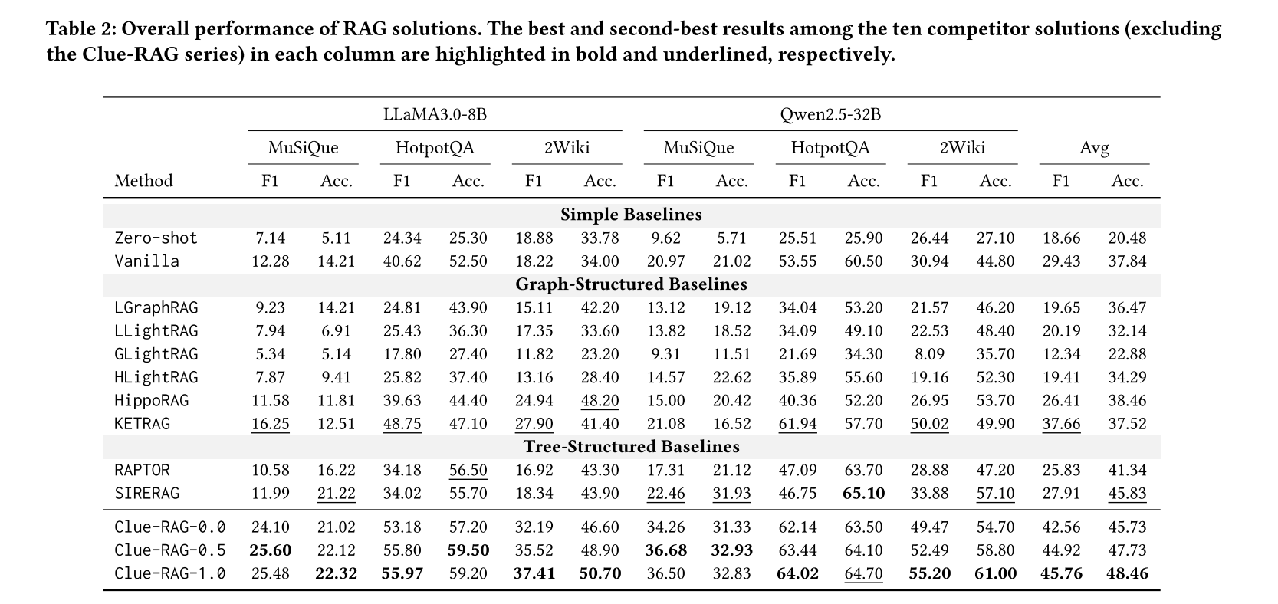
ATAI
Advanced Technique of Artificial Intelligence
ATAI
ChongqingUniversity _{AdvancedTechniqueof}
of Technology Artificial Intelligence
Chongqing University of
Technology
Chongqing University ^{ATAI}
_{of Technology} Advanced Techniqueof
Artificial Intelligence
Chongqing University of Technology
Chongqing University of Technology
Experiments

Slide 6
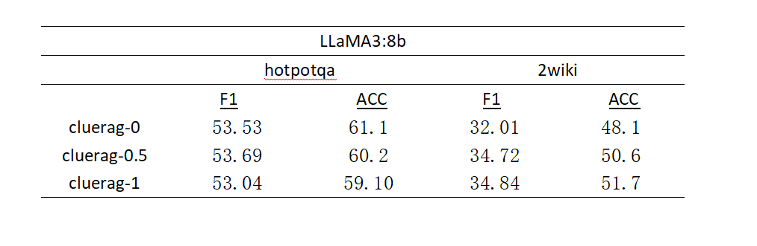
ATAI
Advanced Technique of Artificial Intelligence
ATAI
ChongqingUniversity _{AdvancedTechniqueof}
of Technology Artificial Intelligence
Chongqing University of
Technology
Chongqing University ^{ATAI}
_{of Technology} Advanced Techniqueof
Artificial Intelligence
Chongqing University of Technology
Chongqing University of Technology
Experiments

Slide 7
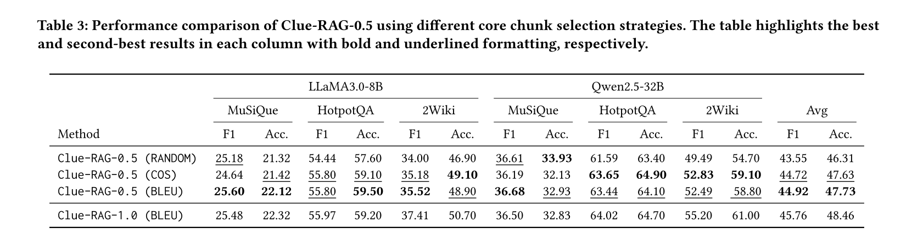
ATAI
Advanced Technique of Artificial Intelligence
ATAI
ChongqingUniversity _{AdvancedTechniqueof}
of Technology Artificial Intelligence
Chongqing University of
Technology
Chongqing University ^{ATAI}
_{of Technology} Advanced Techniqueof
Artificial Intelligence
Chongqing University of Technology
Chongqing University of Technology
Experiments

Slide 8
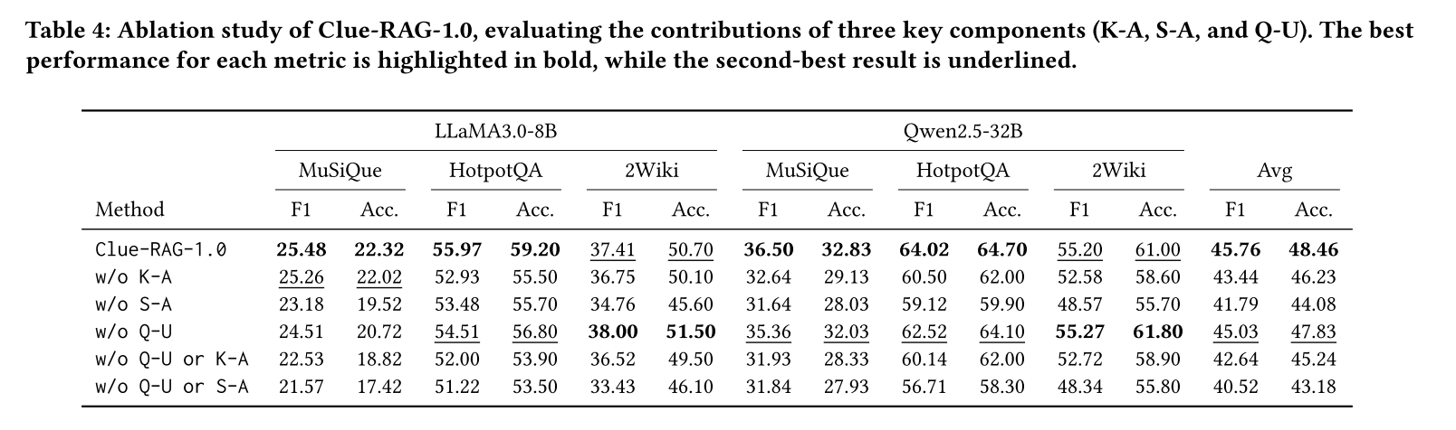
ATAI
Advanced Technique of Artificial Intelligence
ATAI
ChongqingUniversity _{AdvancedTechniqueof}
of Technology Artificial Intelligence
Chongqing University of
Technology
Chongqing University ^{ATAI}
_{of Technology} Advanced Techniqueof
Artificial Intelligence
Chongqing University of Technology
Chongqing University of Technology
Experiments

Slide 9


ATAI
Advanced Technique of Artificial Intelligence
ATAI
ChongqingUniversity _{AdvancedTechniqueof}
of Technology Artificial Intelligence
Chongqing University of
Technology
Chongqing University ^{ATAI}
_{of Technology} Advanced Techniqueof
Artificial Intelligence
Chongqing University of Technology
Chongqing University of Technology
Thanks!

